Slide 1

Chapter 13 Part 1
Business Intelligence and Data Warehouses
The slides in this presentation have been adapted from slides provided with the textbook, Database Systems: Design, Implementation, and Management,
12E, Cornel and Morris, Copyright © 2017 Cengage Learning.

Slide 2
Learning Objectives
How business intelligence provides a comprehensive business decision support framework
About business intelligence architecture, its evolution, and reporting styles
Copyright © 2017 Cengage Learning
2

Slide 3
The Need for Data Analysis
Managers track daily transactions to evaluate how the business is performing
Strategies should be developed to meet organizational goals using operational databases
Data analysis provides information about short-term tactical evaluations and strategies
Copyright © 2017 Cengage Learning
3

Slide 4
Business Intelligence (BI)
Comprehensive, cohesive, integrated set of tools and processes
Captures, collects, integrates, stores, and analyzes data
Purpose - Generate and present information to support business decision making
Allows a business to transform:
Data into information
Information into knowledge
Knowledge into wisdom
Copyright © 2017 Cengage Learning
4

Slide 5
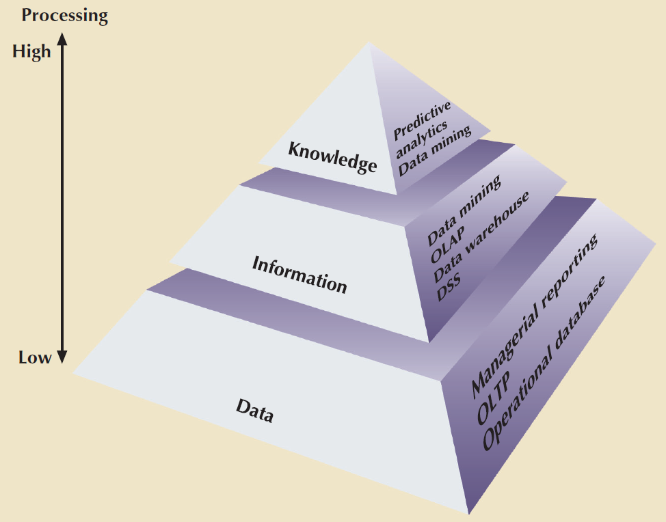
Figure 13. 15 - Extracting Knowledge from Data
Copyright © 2017 Cengage Learning
5

Slide 6
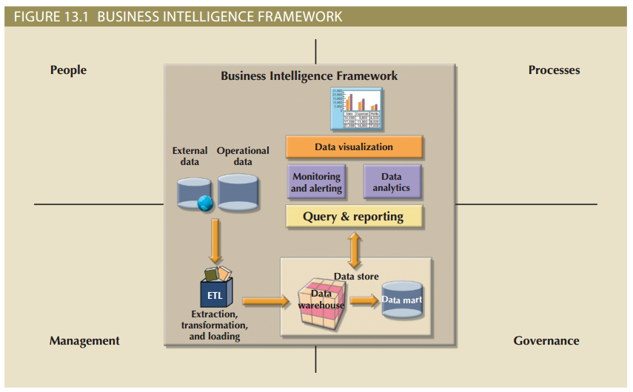
Figure 13.1 - Business Intelligence Framework
Copyright © 2017 Cengage Learning
6

Slide 7
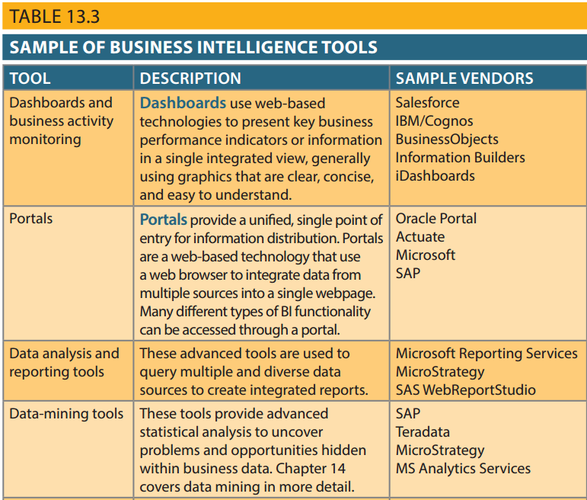
Business Intelligence Tools
Dashboards and business activity monitoring
Dashboards: Shows key business performance indicators in a single integrated view
Portals: Integrate data using web browser from multiple sources into a single webpage
Data analysis and reporting tools
Data-mining tools
Data warehouses (DW)
OLAP tools and data visualization
Copyright © 2017 Cengage Learning
7

Slide 8
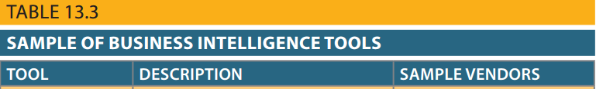
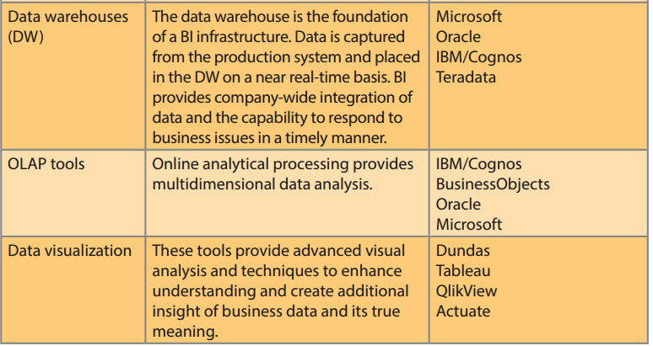
Copyright © 2017 Cengage Learning
8

Slide 9
Practices to Manage Data
Master data management (MDM): Collection of concepts, techniques, and processes for identification, definition, and management of data elements
Governance: Methods for controlling business health and for consistent decision making
Key performance indicators (KPI): Numeric or scale-based measurements that assess company’s effectiveness in reaching its goals
Copyright © 2017 Cengage Learning
9

Slide 10
Practices to Manage Data
Data visualization: Abstracting data to provide information in a visual format
Enhances the user’s ability to efficiently comprehend the meaning of the data
Techniques
Pie charts and bar charts
Line graphs
Scatter plots
Gantt charts
Heat maps
Copyright © 2017 Cengage Learning
10

Slide 11
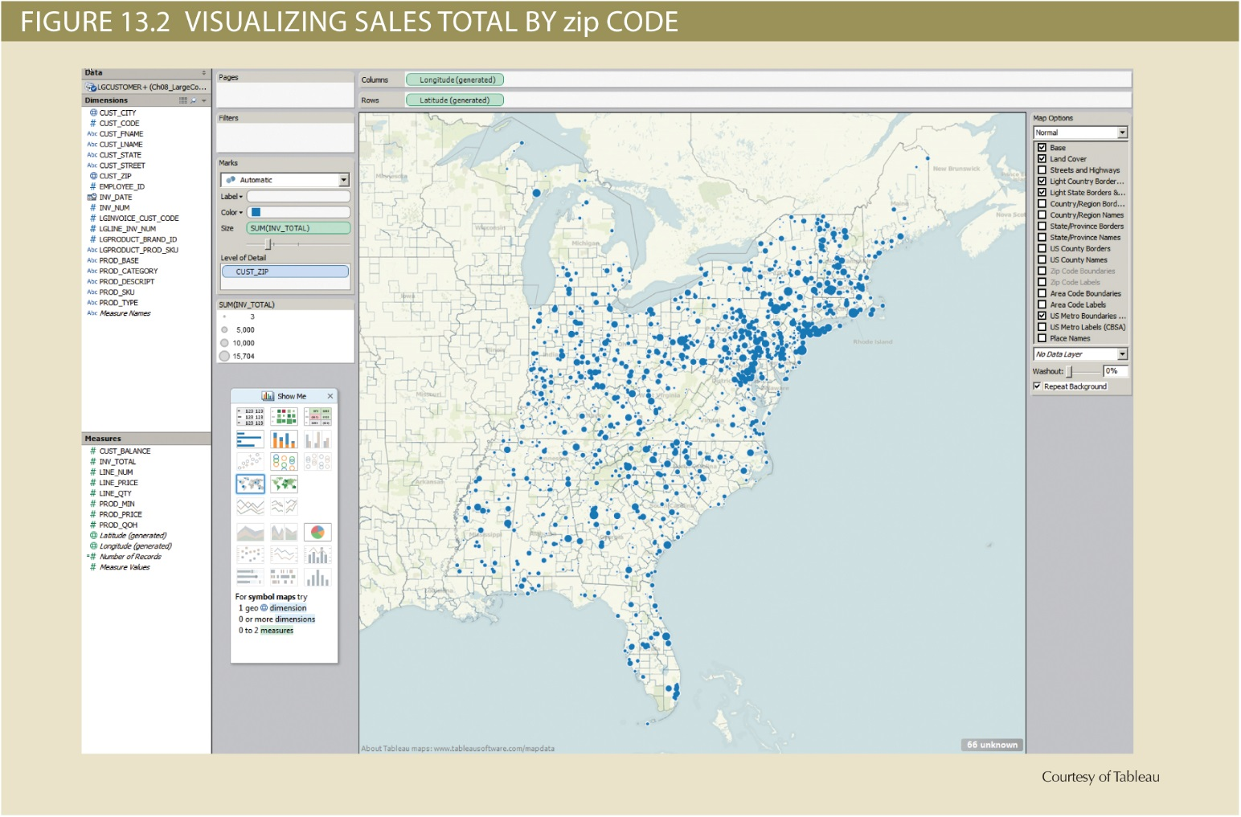
Copyright © 2017 Cengage Learning
11

Slide 12
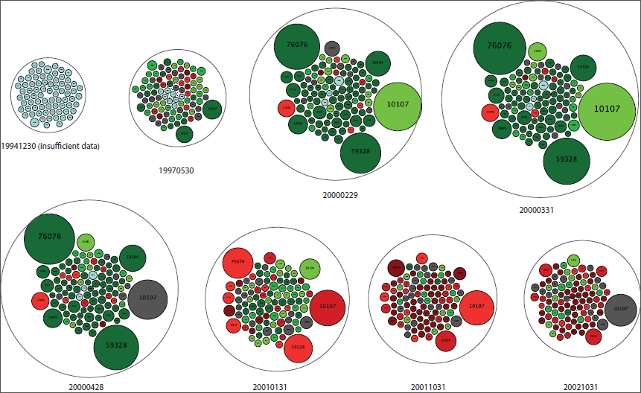
Dot Com Crash
Copyright © 2017 Cengage Learning
12

Slide 13
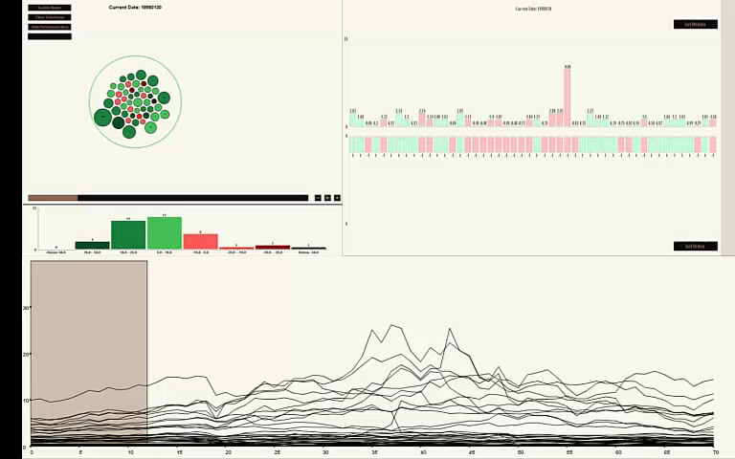
Final Viz Uses Multiple Coordinated Views
Copyright © 2017 Cengage Learning
13

Slide 14
Reporting Styles of a Modern BI System
Advanced reporting
Monitoring and alerting
Advanced data analytics
Copyright © 2017 Cengage Learning
14

Slide 15
Business Intelligence Benefits
Improved decision making
Integrating architecture
Common user interface for data reporting and analysis
Common data repository fosters single version of company data
Improved organizational performance
Copyright © 2017 Cengage Learning
15

Slide 16
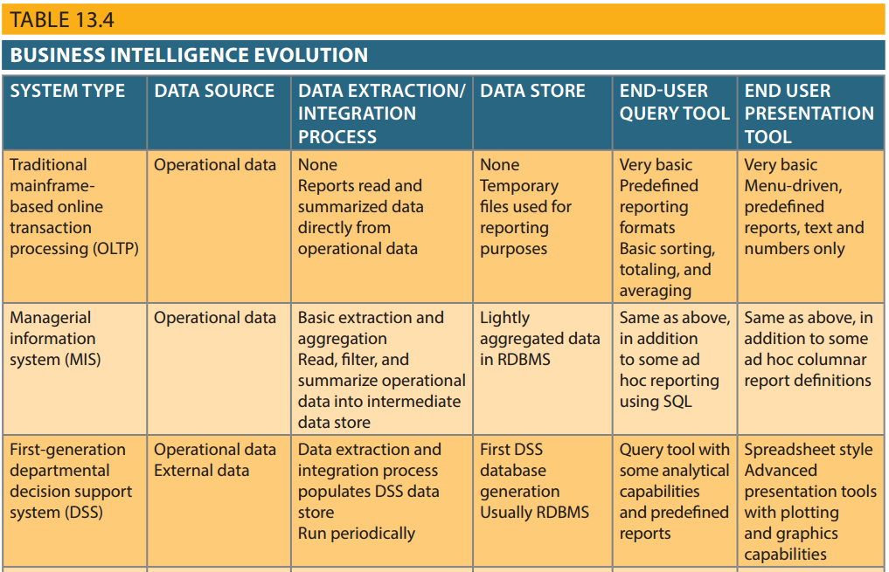
Copyright © 2017 Cengage Learning
16

Slide 17
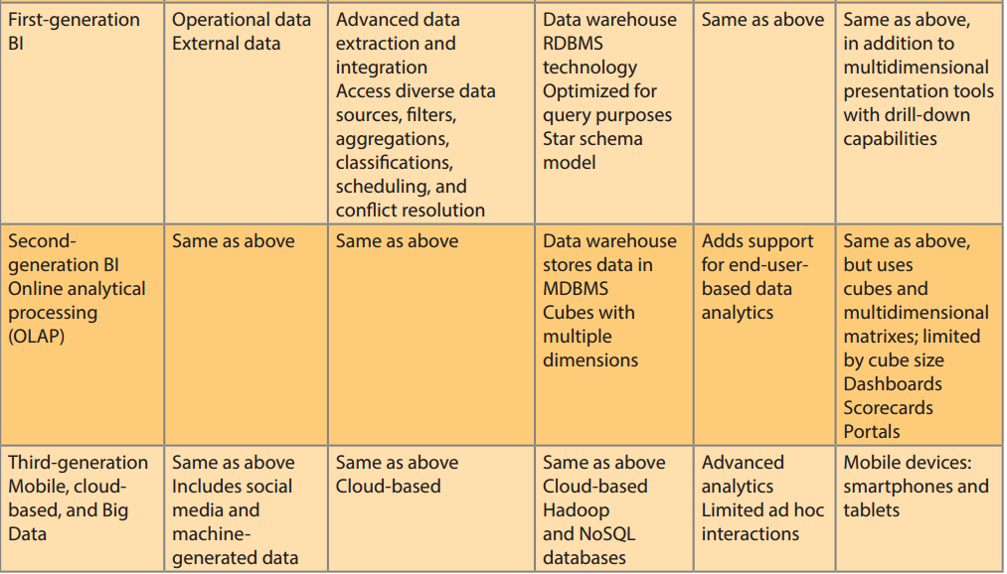
Copyright © 2017 Cengage Learning
17

Slide 18
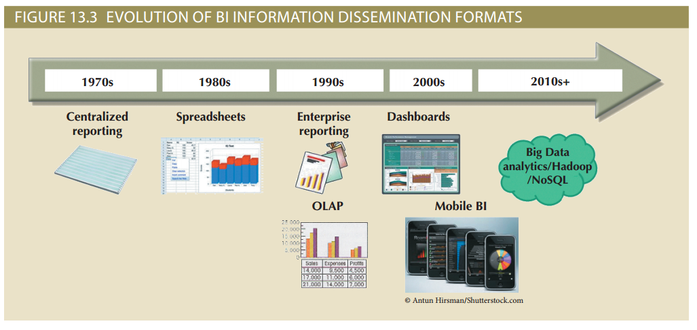
Copyright © 2017 Cengage Learning
18

Slide 19
Business Intelligence Technology Trends
Data storage improvements
Business intelligence appliances
Business intelligence as a service
Big Data analytics
Personal analytics
Copyright © 2017 Cengage Learning
19

Slide 20
Summary
Business intelligence generates information used to support decision making
BI covers a range of technologies, applications, and functionalities
Decision support systems were the precursor of current generation BI systems
Copyright © 2017 Cengage Learning
20

Slide 21
Task
Find an example of a data warehouse by searching the Internet.
Copyright © 2017 Cengage Learning
21

